Slide 1
AUTHOR: TESSA NEJLA AYVAZOGLU, KUN CHEN Date: AUGUST, 12, 2024
Optimizing Gym Utilization for GoodLife Fitness
DATE:12/08/2024

Slide 2
Table of Contents
Introduction
Problems
Data Overview
Project Scope
Expected Outcomes
Next Steps
Questions and Discussion

Slide 3
Project Objective
To optimize gym equipment and group fitness class utilization at GoodLife Fitness.
To enhance customer satisfaction and maximize profits.
To address two main problems to improve gym utilization.

Slide 4
Problem A - Optimizing Group Fitness Class Utilization
Issue:
GoodLife offers group fitness classes in two capacities: 25 and 15.
Some classes are consistently fully booked but have a low attendance rate.
GoodLife wants to increase the number of available spaces by predicting whether a member will attend.
If a member is predicted not to attend, that space can be made available to others.
Dataset Features:
booking_id: Nominal. Unique identifier for the booking.
months_as_member: Discrete. Number of months as a member.
weight: Continuous. Member's weight in kg.
days_before: Discrete. Number of days before the class the member registered.
day_of_week: Nominal. Day of the week of the class.
time: Ordinal. Time of day for the class (AM or PM).
category: Nominal. Category of the fitness class.
attended: Nominal. Whether the member attended the class (1) or not (0).

Slide 5
Problem A - Data Summary
Data Summary:
Class bookings, membership duration, weight, days before class, day, time, and class category.

Slide 6
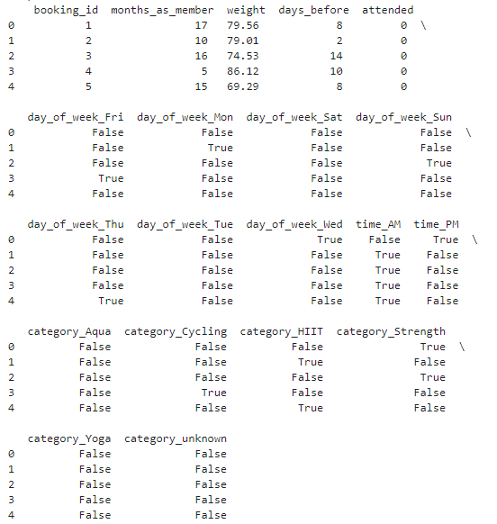
Problem A - Optimizing Group Fitness Class Utilization

Slide 7
Project Scope - Problem A
Feature Importance Analysis:
Identify features that significantly impact class attendance.
Exploratory Data Analysis (EDA):
Clean the data, identify redundant features, and explore additional features for improved accuracy.
Model Development:
Develop a predictive model for class attendance.
Evaluate and refine the model to improve accuracy.
Optimization Recommendations:
Provide strategies for increasing available spaces based on attendance predictions.

Slide 8
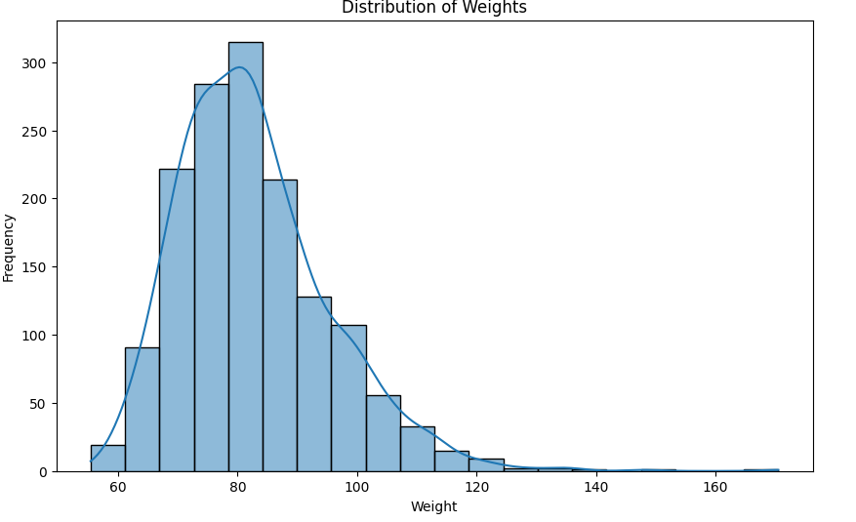
Problem A - Optimizing Group Fitness Class Utilization

Slide 9
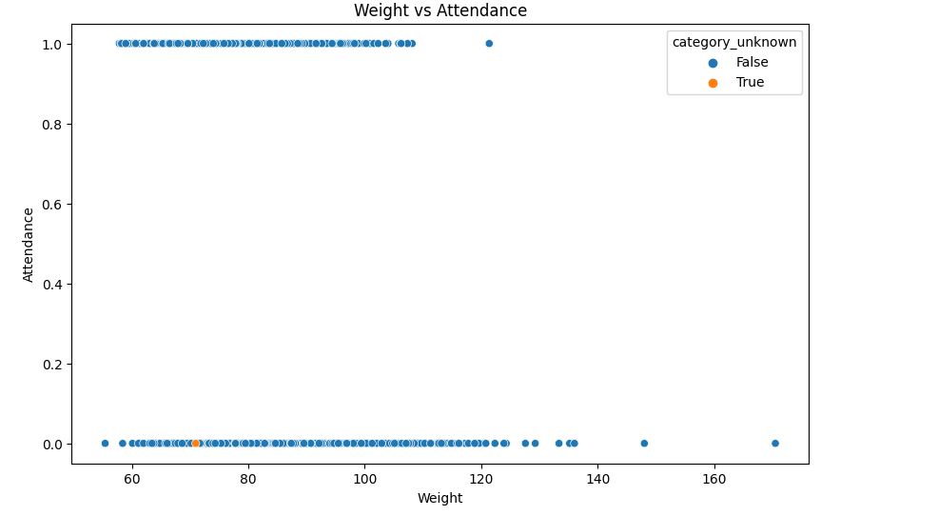
Problem A - Optimizing Group Fitness Class Utilization

Slide 10
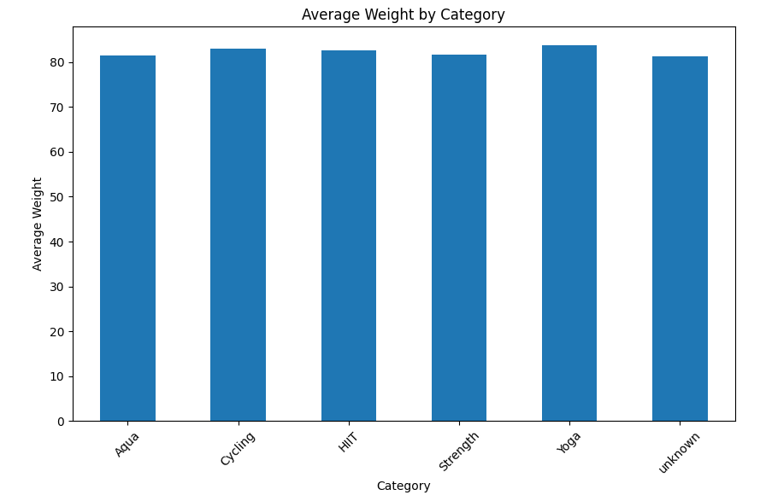
Problem A - Optimizing Group Fitness Class Utilization

Slide 11
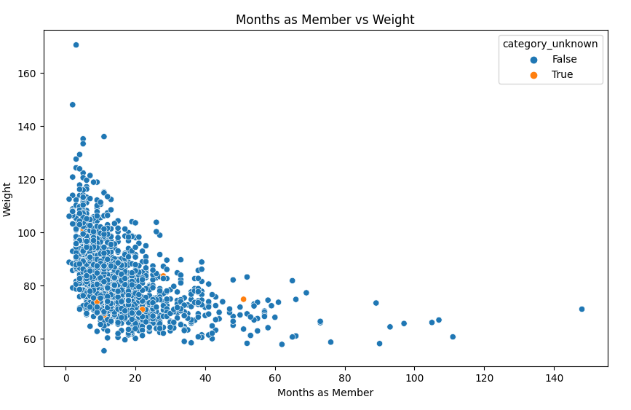
Problem A - Optimizing Group Fitness Class Utilization

Slide 12
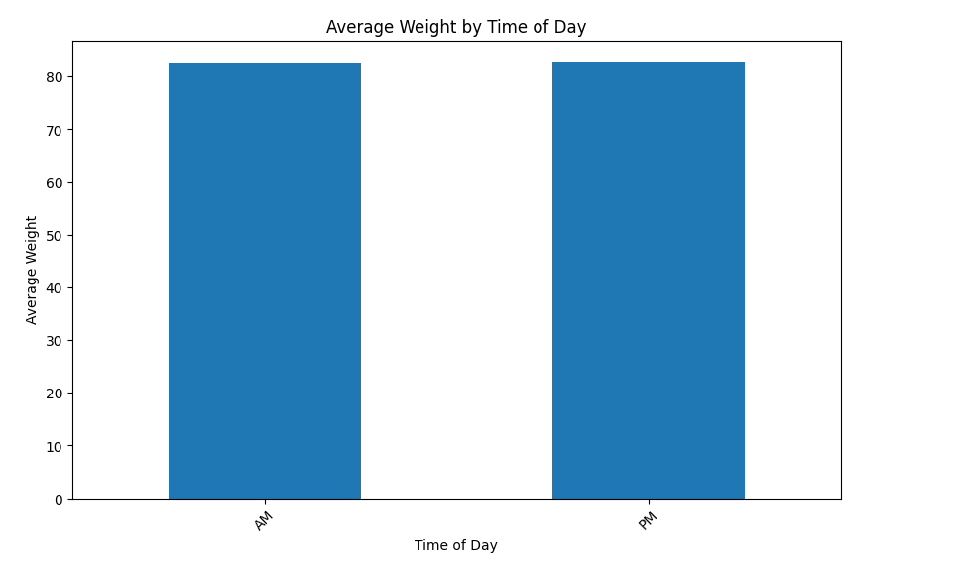
Problem A - Optimizing Group Fitness Class Utilization

Slide 13
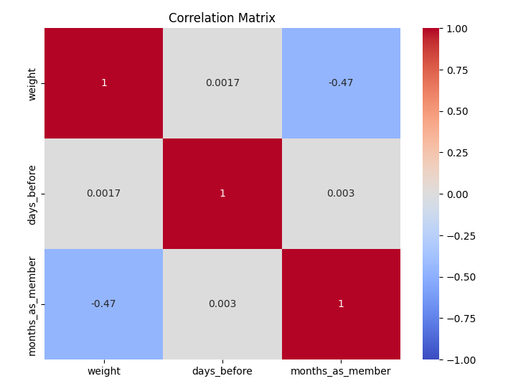
Problem A - Optimizing Group Fitness Class Utilization

Slide 14
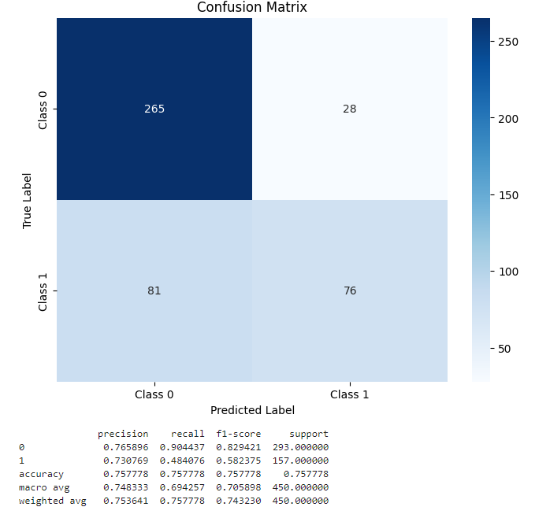
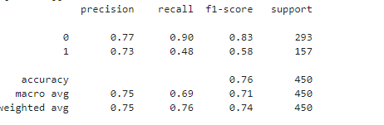
Problem A - Optimizing Group Fitness Class Utilization
Results and Evaluation
Accuracy: The overall accuracy of the model is 68%.
Class Performance:
Class 0 (Not Attended): High accuracy and f1-score. The model generally predicts this class correctly.
Class 1 (Attended): Lower accuracy and f1-score. The model has difficulty predicting this class.
Recommendations:
Improve Model Performance: Enhance the model's performance through feature engineering and hyperparameter optimization.
Data Analysis: Conduct further data analysis and test the model's generalizability with different datasets.

Slide 15
Problem B - Optimizing Gym Equipment Utilization
Issue:
GoodLife has recorded the number of people in the gym every 10 minutes over the past year.
We aim to predict how crowded the gym will be in the future to encourage usage during less crowded times.
Dataset Features:
Label:
Number of people: Count of people in the gym at a given time.
Features:
date: Date of data collection (string).
timestamp: Number of seconds since the start of the day (int).
day_of_week: Day of the week (int; 0 [Monday] - 6 [Sunday]).
is_weekend: Whether it’s a weekend (int; 0 or 1).
is_holiday: Whether it’s a federal holiday (int; 0 or 1).
temperature: Temperature in Fahrenheit (float).
is_start_of_semester: Whether it’s the start of a school semester (int; 0 or 1).
month: Month (int; 1 [January] - 12 [December]).
hour: Hour of the day (int; 0 - 23)

Slide 16
Problem B - Data Summary
Data Summary:
Gym occupancy data, date, timestamp, weather, holiday status, temperature, semester start, and hour.

Slide 17
Project Scope - Problem B
Feature Importance Analysis:
Identify features that significantly impact class attendance.
Exploratory Data Analysis (EDA):
Clean the data, identify redundant features, and explore additional features for improved accuracy.
Model Development:
Develop a predictive model for class attendance.
Evaluate and refine the model to improve accuracy.
Optimization Recommendations:
Provide strategies for increasing available spaces based on attendance predictions.

Slide 18
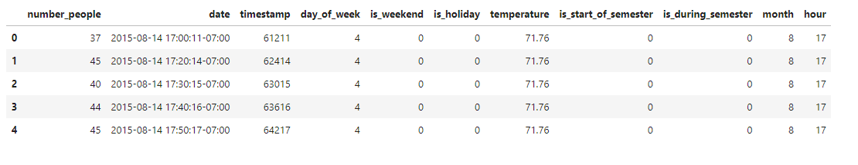

Slide 19
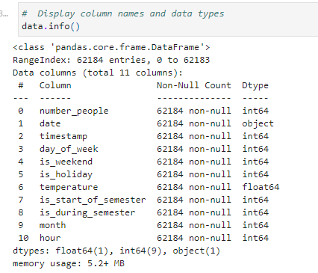

Slide 20
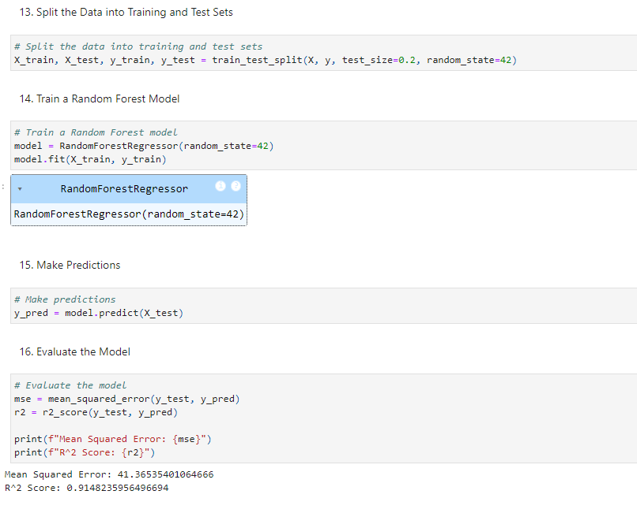

Slide 21
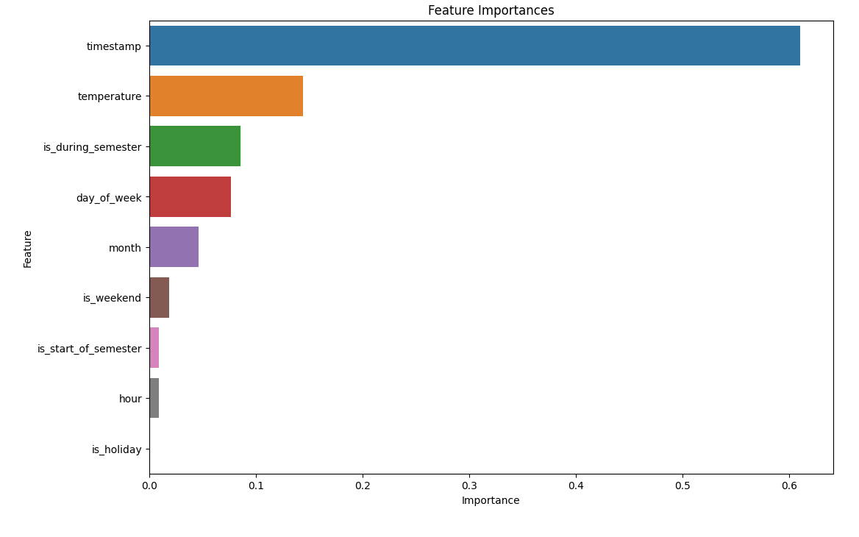

Slide 22
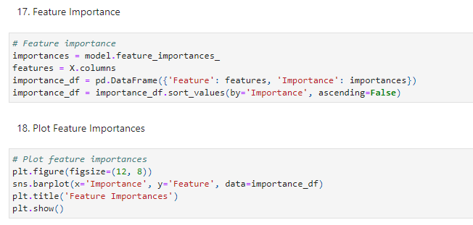

Slide 23
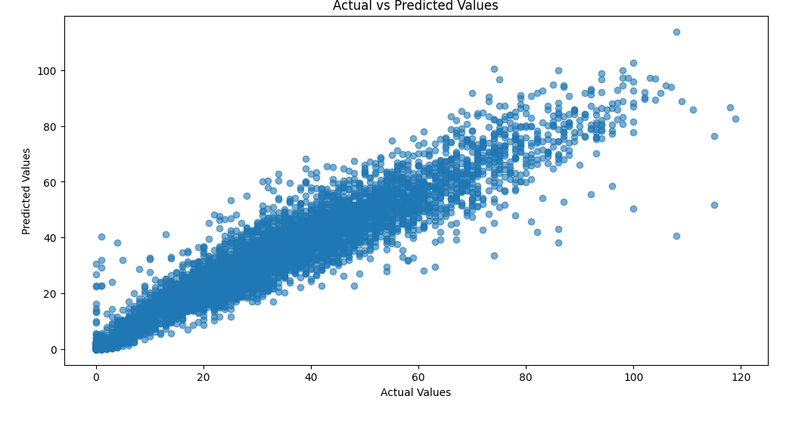

Slide 24
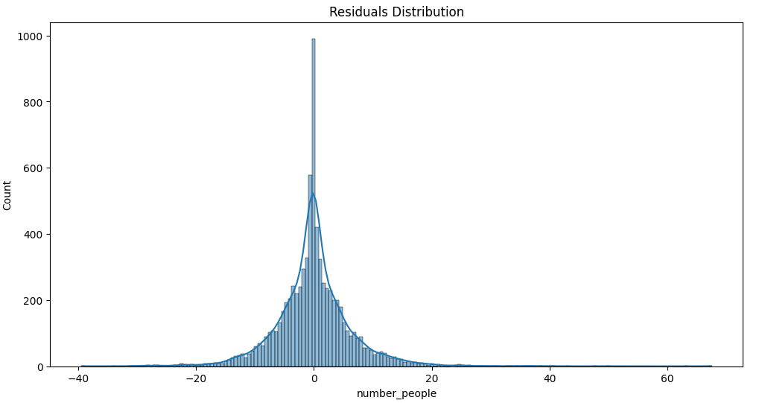

Slide 25
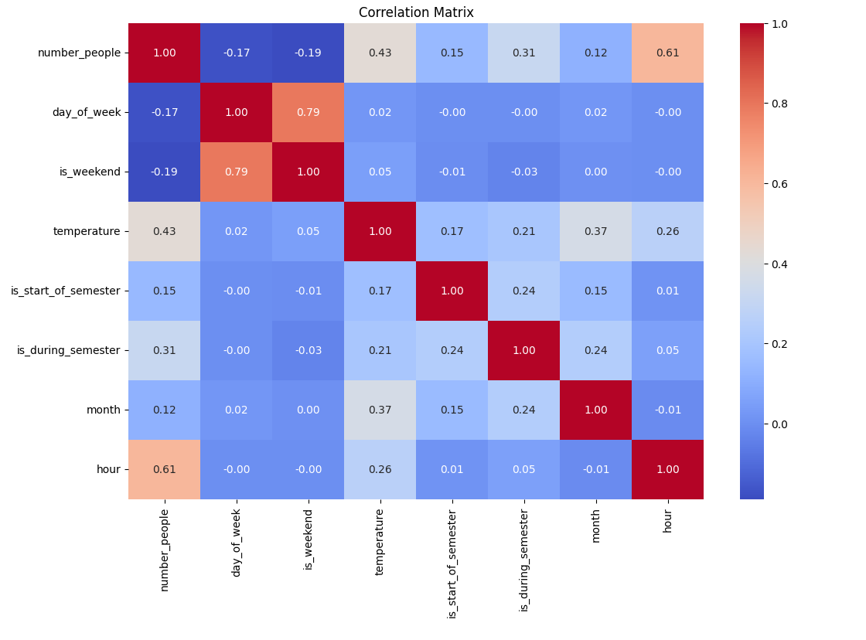

Slide 26
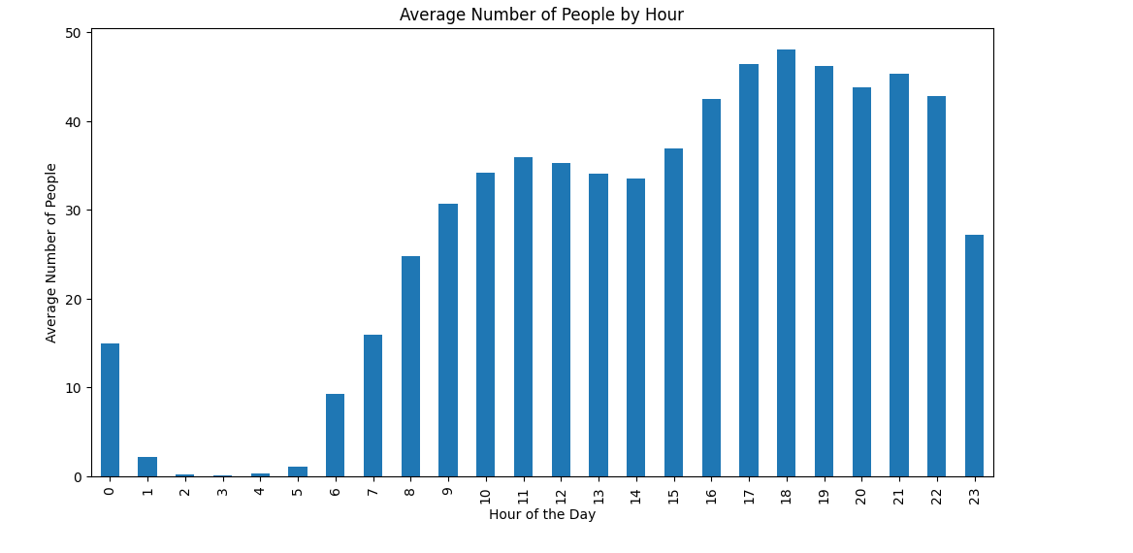

Slide 27
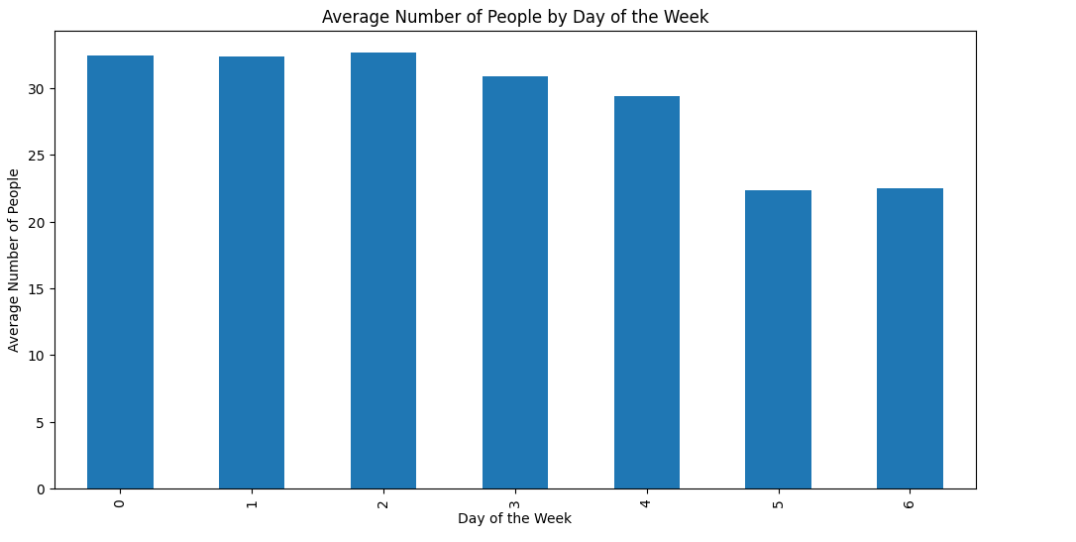

Slide 28
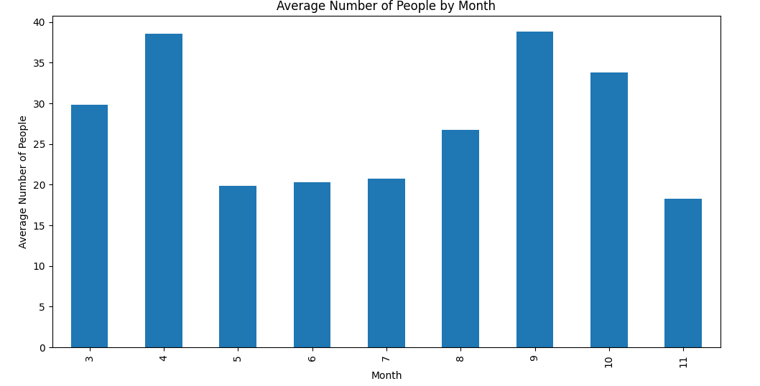

Slide 29
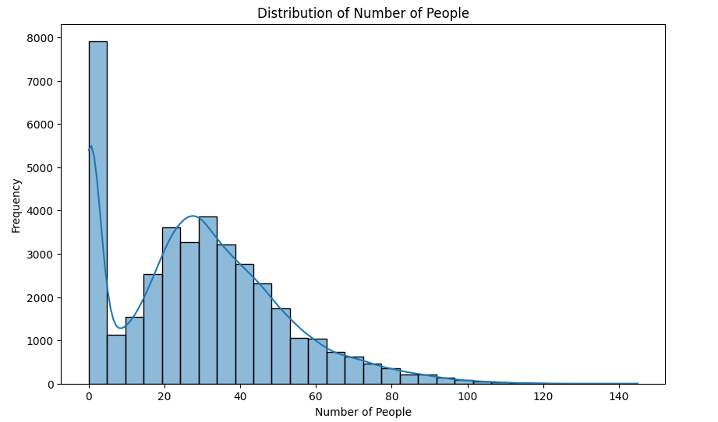

Slide 30
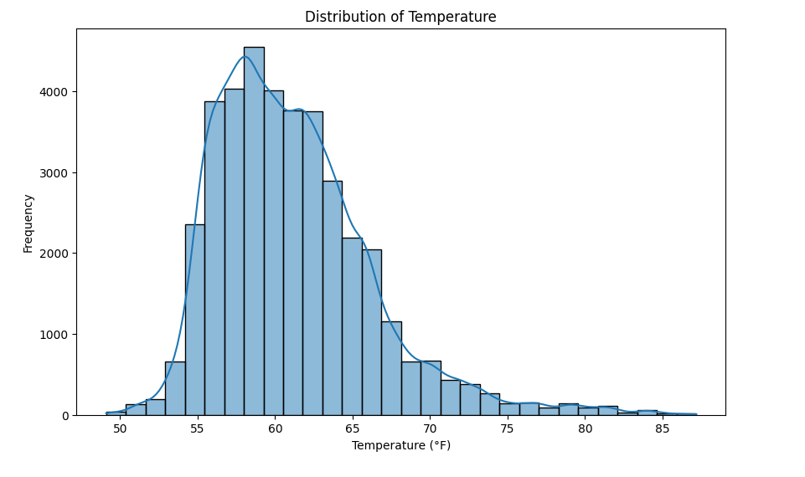

Slide 31
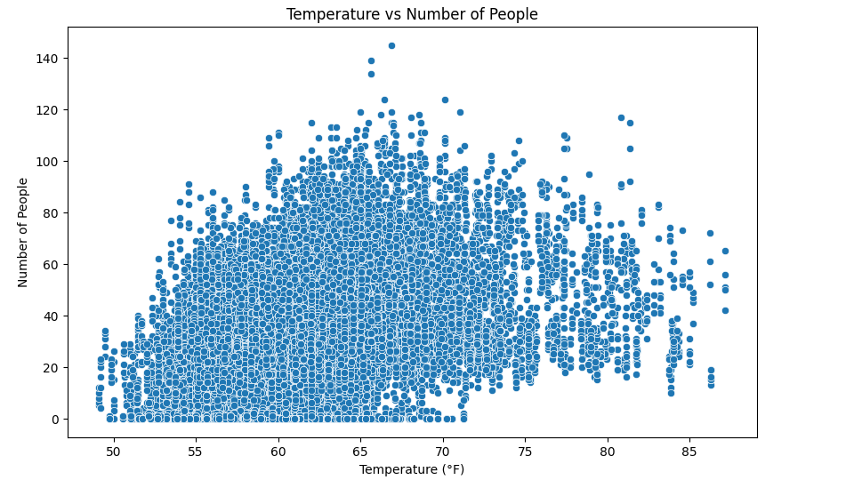

Slide 32
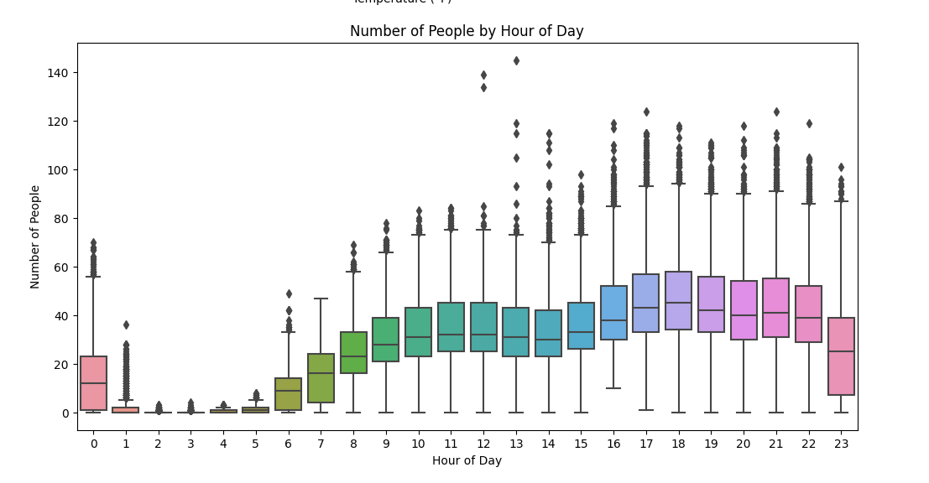

Slide 33
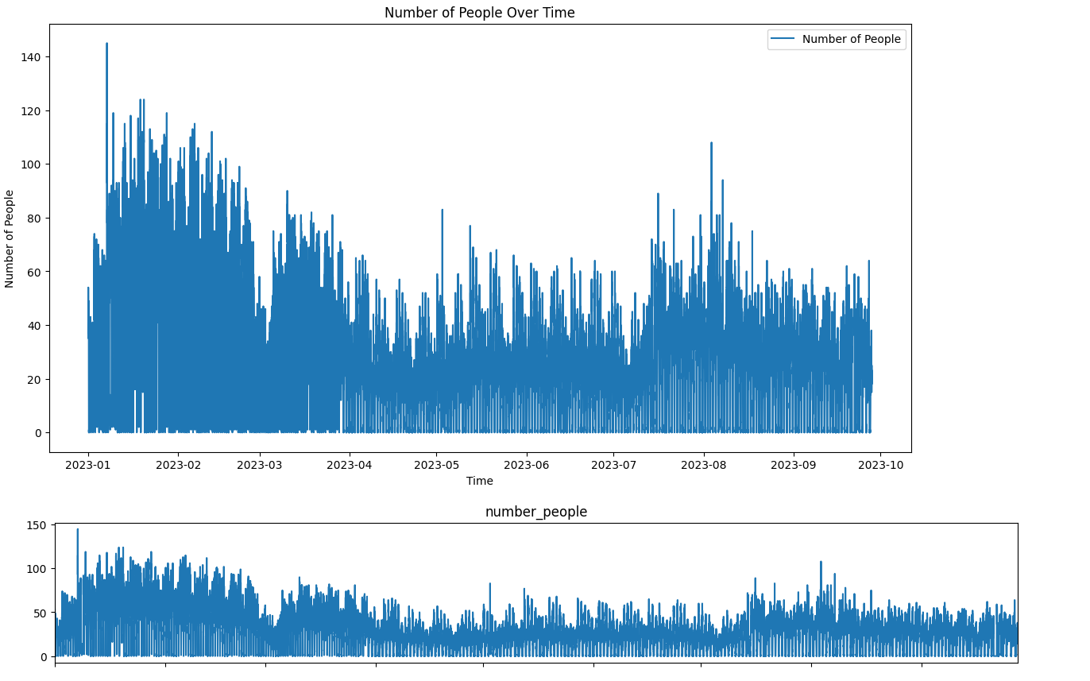

Slide 34
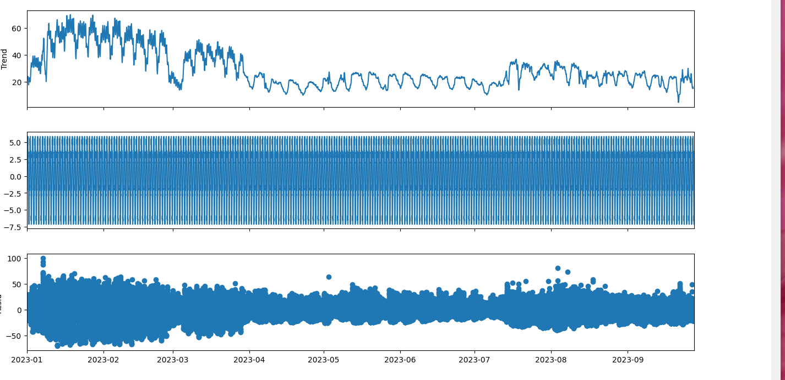

Slide 35
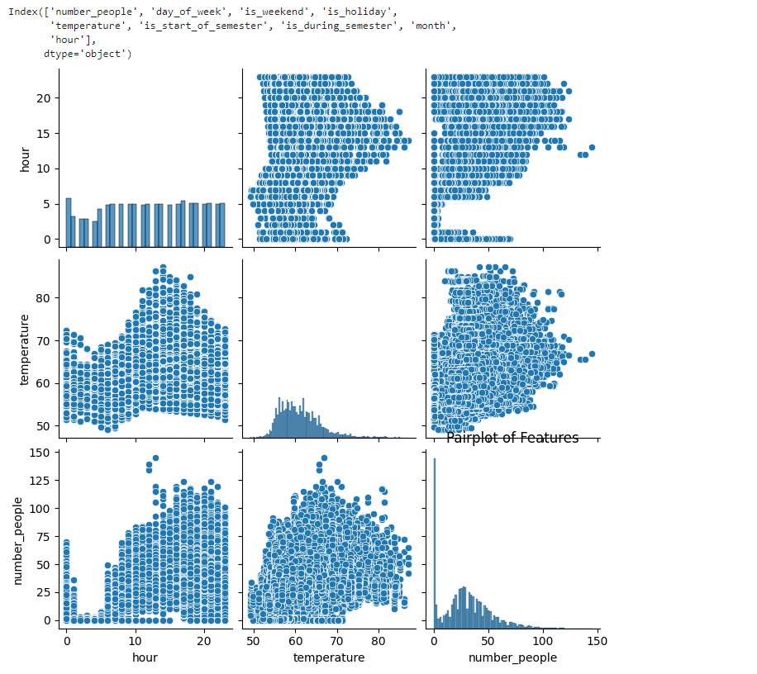

Slide 36
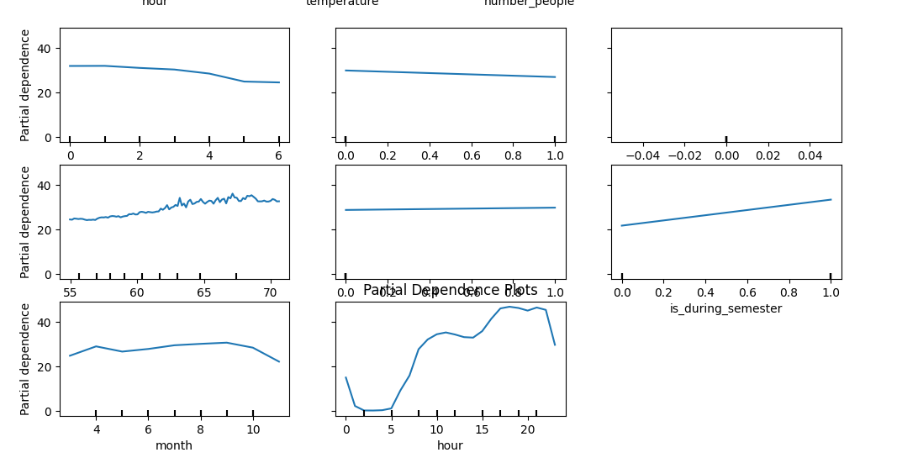

Slide 37
Conclusion:
This analysis provides valuable insights to optimize gym equipment utilization and encourage usage during less crowded times. The key findings from the graphs are as follows:
Peak Hours: The gym is most crowded during morning and evening hours. Incentives can be created to encourage users to visit during less busy times.
Temperature and Attendance Relationship: There is a positive correlation between temperature and the number of people in the gym. Strategies can be developed to optimize gym usage based on temperature forecasts.
Trends Over Time: There are noticeable fluctuations and trends in gym attendance over time, with certain periods showing increased or decreased usage. Strategies can be implemented to direct users to less crowded times during these periods.
Model Accuracy: The predicted values closely match the actual values, indicating that the model is reliable for future predictions.
These findings can be used to optimize gym usage, improve energy management, and enhance customer satisfaction.

Slide 38
Q&A: Open floor for questions from the audience.
THANK YOU!

